Slide 1
Graphs
Implementation
Pg 566
Computer Science 2
BSc in Software Development Year 3 2004/05
Notes:
Graphs
Computer Science 2
BSc in Software Development - Year 3

Slide 2
Array Based Implementation
Definition:
Adjacency Matrix: For a graph with N nodes, an N by N table that shows the existence (and weights) of all edges in a Graph.
At any time, within this representation of a Graph numVertices is the number of vertices in the Graph.
V(Graph) is contained in vertices[0] .. vertices[numVertices–1]
E(Graph) is contained in the square array edges[0][0] .. edges[numVertices–1][numVertices–1]
Computer Science 2
BSc in Software Development Year 3 2004/05

Slide 3
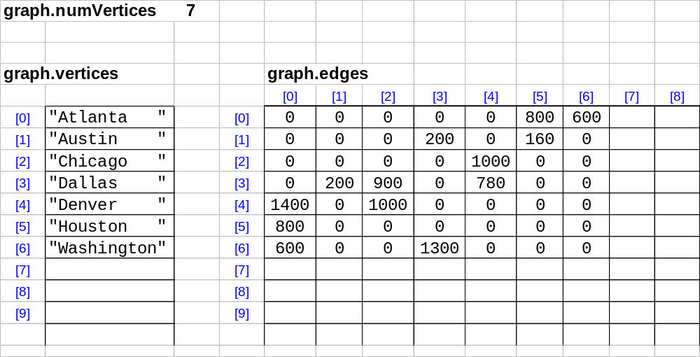
Dallas
200
1300
Austin
200
780
Washington
Denver
900
600
1000
1400
600
1000
Atlanta
Chicago
800
Houston
800
160
Computer Science 2
BSc in Software Development Year 3 2004/05

Slide 4
Graph.h
// This file contains the definition of class // GraphType that represents the Graph ADT.
template<class VertexType>
// Assumption: VertexType is a type for which the // "=", "==", and "<<" operators are defined
class GraphType
{
public:
GraphType(); // constructor, default of 50 vertices.
GraphType(int maxV); // parameterized constructor, maxV <= 50.
~GraphType(); // destructor
Computer Science 2
BSc in Software Development Year 3 2004/05

Slide 5
void MakeEmpty();
// Function: Initialize graph to the empty state.
// Post: Graph is empty.
bool IsEmpty() const;
// Function: Determines if the graph is empty.
// Post: Function value = (graph is empty)
bool IsFull() const;
// Function: Determines if the graph is full.
// Post: Function value = (graph is full).
Computer Science 2
BSc in Software Development Year 3 2004/05

Slide 6
void AddVertex(VertexType);
// Function: Adds vertex to the graph.
// Pre: Graph is not full.
// Post: vertex is in V(graph)
void AddEdge(VertexType, VertexType, int);
// Function: Adds an edge with the specified
// weight from fromVertex to toVertex.
// Pre: fromVertex and toVertex are in V(graph)
// Post: (fromVertex, toVertex) is in E(graph)
// with the specified weight.
Computer Science 2
BSc in Software Development Year 3 2004/05

Slide 7
int WeightIs(VertexType, VertexType);
// Function: Determines the weight of the edge
// from fromVertex to toVertex.
// Pre: fromVertex and toVertex are in V(graph)
// Post: Function value = weight of // (fromVertex, toVertex).
void GetToVertices(VertexType, QueType<VertexType>&);
// Function: Returns a queue of the vertices
// that are adjacent from vertex.
// Pre: vertex is in V(graph).
// Post: vertexQ contains the names of all
// the vertices that are heads of edges for // which vertex is the tail.
Computer Science 2
BSc in Software Development Year 3 2004/05

Slide 8
void ClearMarks();
// Function: Sets marks for all vertices to // false.
// Post: All makrs have been set to false.
void MarkVertex(VertexType);
// Function: Sets mark for vertex to true.
// Pre: vertex is in V(graph).
// Post: IsMarked(vertex) is true.
bool IsMarked(VertexType) const;
// Function: Determines if vertex has been // marked.
// Pre: vertex is in V(graph).
// Post: Function value = (vertex is marked // true)
Computer Science 2
BSc in Software Development Year 3 2004/05

Slide 9
private:
int numVertices;
int maxVertices;
VertexType* vertices;
int edges[50][50];
bool* marks;
// marks[i] is mark for vertices[i].
};
#include "Graph.cpp"
Computer Science 2
BSc in Software Development Year 3 2004/05

Slide 10
Graph.cpp
// This file contains the implementations of the
// member functions for class GraphType that are
// given in the text.
Computer Science 2
BSc in Software Development Year 3 2004/05

Slide 11
template<class VertexType>
GraphType<VertexType>::GraphType()
// Post: Arrays of size 50 are dynamically allocated for
// marks and vertices. numVertices is set to 0;
// maxVertices is set to 50.
{
numVertices = 0;
maxVertices = 50;
vertices = new VertexType[50];
marks = new bool[50];
}
Computer Science 2
BSc in Software Development Year 3 2004/05

Slide 12
template<class VertexType>
GraphType<VertexType>::GraphType(int maxV)
// Post: Arrays of size maxV are dynamically
// allocated for marks and vertices.
// numVertices is set to 0; maxVertices is set to maxV.
{
numVertices = 0;
maxVertices = maxV;
vertices = new VertexType[maxV];
marks = new bool[maxV];
}
Computer Science 2
BSc in Software Development Year 3 2004/05

Slide 13
template<class VertexType>
GraphType<VertexType>::~GraphType()
// Post: arrays for vertices and marks have been // deallocated.
{
delete [] vertices;
delete [] marks;
}
Computer Science 2
BSc in Software Development Year 3 2004/05

Slide 14
template<class VertexType>
void GraphType<VertexType>::AddVertex(VertexType vertex)
// Post: vertex has been stored in vertices.
// Corresponding row and column of edges have been
// set to NULL_EDGE.
// numVertices has been incremented.
{
vertices[numVertices] = vertex;
for (int index=0; index<numVertices; index++)
{
edges[numVertices][index] = NULL_EDGE;
edges[index][numVertices] = NULL_EDGE;
}
numVertices++;
}
Computer Science 2
BSc in Software Development Year 3 2004/05

Slide 15
template<class VertexType>
int IndexIs(VertexType * vertices,
VertexType vertex)
// Post: Function value = index of vertex in vertices.
{
int index = 0;
while (!(vertex == vertices[index]))
index++;
return index;
}
Computer Science 2
BSc in Software Development Year 3 2004/05

Slide 16
template<class VertexType>
void GraphType<VertexType>::AddEdge(
VertexType fromVertex,
VertexType toVertex, int weight)
// Post: Edge (fromVertex, toVertex) is stored in edges.
{
int row;
int column;
row = IndexIs(vertices, fromVertex);
col = IndexIs(vertices, toVertex);
edges[row][col] = weight;
}
Computer Science 2
BSc in Software Development Year 3 2004/05

Slide 17
template<class VertexType>
int GraphType<VertexType>::WeightIs(
VertexType fromVertex,
VertexType toVertex)
// Post: Function value = weight associated with the
// edge (fromVertex, toVertex).
{
int row;
int column;
row = IndexIs(vertices, fromVertex);
col = IndexIs(vertices, toVertex);
return edges[row][col];
}
Computer Science 2
BSc in Software Development Year 3 2004/05

Slide 18
template<class VertexType>
void GraphType<VertexType>::GetToVertices(
VertexType vertex,
QueType<VertexType>& adjvertexQ)
{
int fromIndex;
int toIndex;
fromIndex = IndexIs(vertices, vertex);
for (toIndex=0; toIndex<numVertices;toIndex++)
if (edges[fromIndex][toIndex] != NULL_EDGE)
adjvertexQ.Enqueue(vertices[toIndex]);
}
Computer Science 2
BSc in Software Development Year 3 2004/05

Slide 19
Note:
The other methods are left as exercises to implement!
  MakeEmpty()
  IsEmpty()
  IsFull()
  ClearMarks()
  MarkVertex()
  IsMarked()
Computer Science 2
BSc in Software Development Year 3 2004/05

